Slide 1
Unit 4
KERNEL
Time:[2hrs]
Presented by
Er.Harendra Bikram Shah
(Lecturer)
Department of Computer Engineering
NAST

Slide 2
OUTLINES
4.1 Introduction, Architecture of the Kernel ,Types of Kernels
4.2 Context Switching (Kernel and User Mode),Kernel Implementation Process

Slide 3
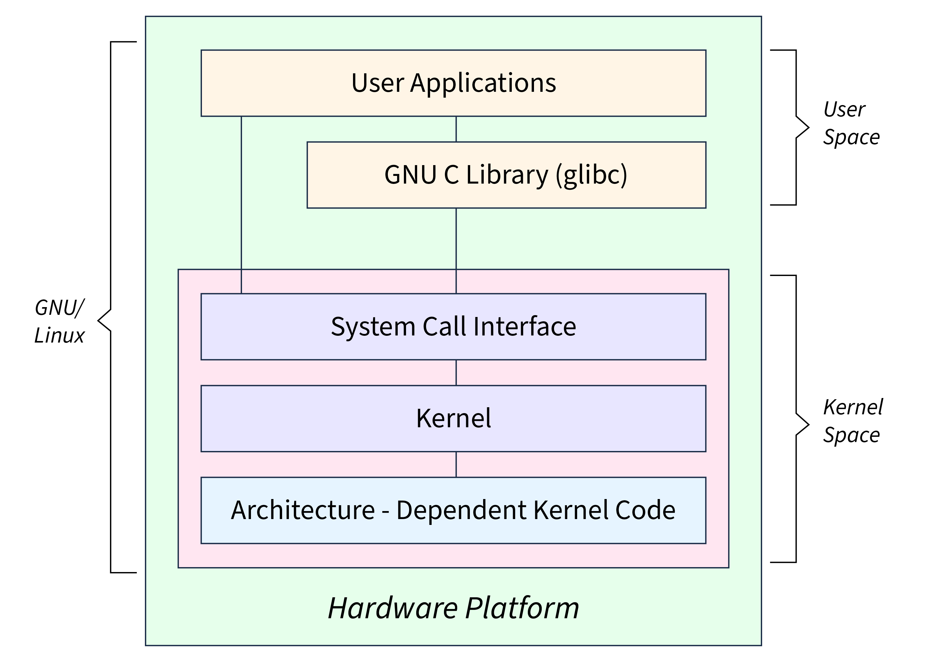
INTRODUCTION
A kernel is a central component of an operating system that manages the operations of computers and hardware.
It acts as a bridge between software applications and the hardware of a computer.

Slide 4

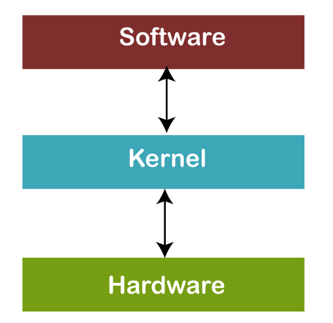
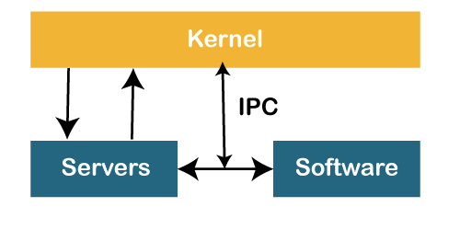
INTRODUCTION
Micro Kernels
Monolithic Kernels

Slide 5
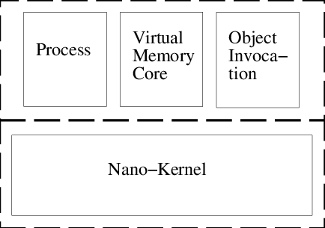
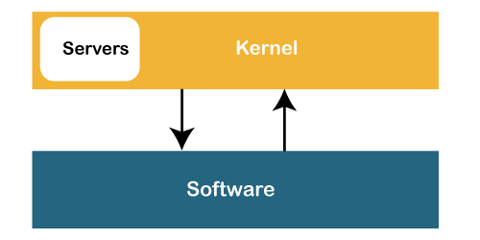
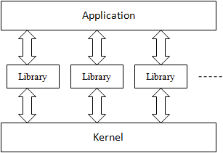
KERNEL TYPES
Exo Kernel
Hybrid Kernel
Nano Kernel

Slide 6
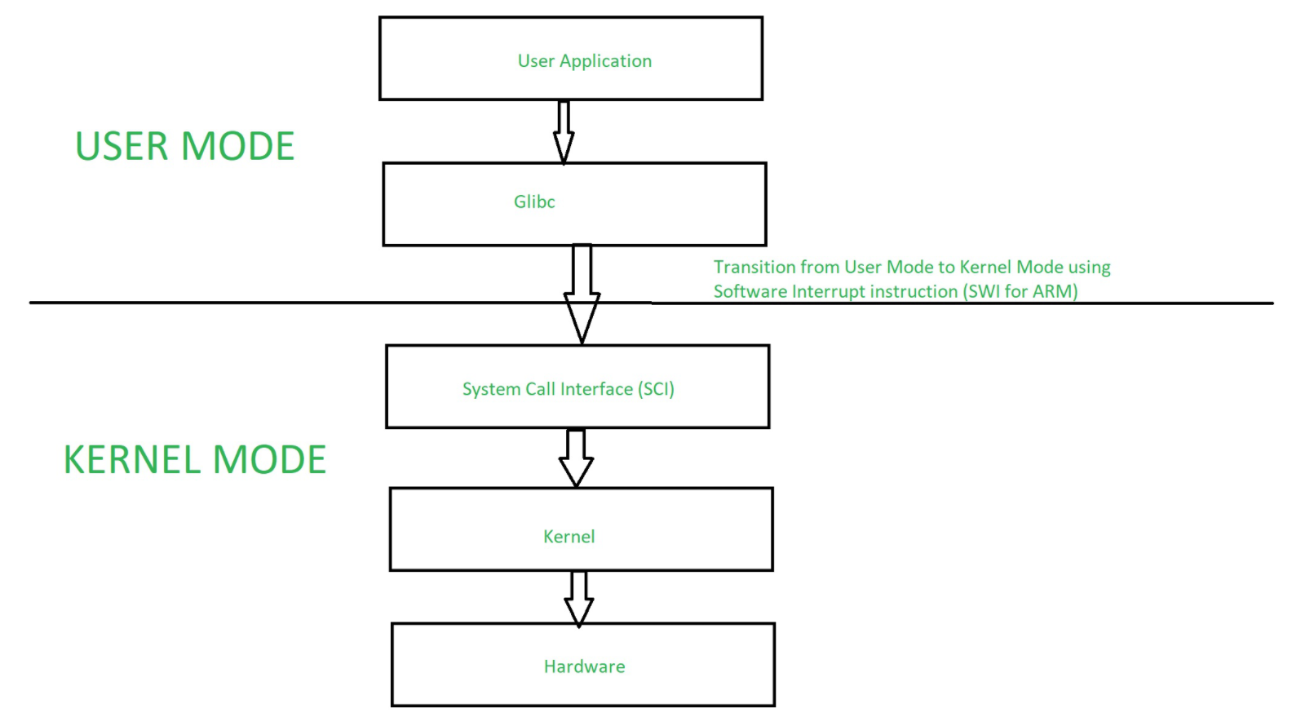
CONTEXT SWITCHING [USER MODE AND KERNEL MODE]

Slide 7
CONTEXT SWITCHING [USER MODE AND KERNEL MODE]
Kernel Mode:
responsible for managing hardware resources, scheduling processes, and handling system calls.
This transition is typically triggered by a hardware interrupt or a software interrupt (system call).
User Mode:
User mode is the normal execution mode for applications.
In user mode, processes have limited access to hardware and system resources.
Context Switching Process:
Interrupt or System Call:
Save Current Context:
Load New Context:
Jump to New Location:
Need of Context Switching
Multitasking:
Resource Management:
System Calls

Slide 8
KERNEL IMPLEMENTATION PROCESS
1. Planning and Design
2. Setting Up the Development Environment
3. Implementing Core Components
4. Kernel Debugging and Testing
5. Optimization and Performance Tuning
6. Security Implementation
7. Documentation
8. Deployment and Maintenance

Slide 9
THANK YOU

